Slide 1
Diagnosis from the keyboard
Can we detect early stages of Parkinson's disease from the typing pattern of people?
By Swee Loke and Daniel Silvestre
Aug 2019

Slide 2

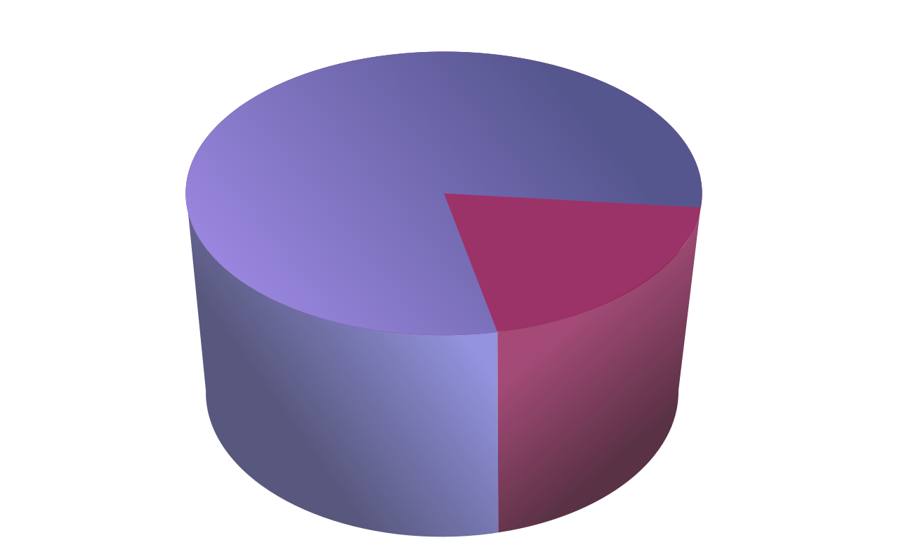
Inspiration
While this is a difficult dataset to work with, there is a rich trove of information. It is a great set to practice preprocessing, attempt to replicate the results of the article, or do your own analysis of keystroke data.
Source: https://www.kaggle.com/valkling/tappy-keystroke-data-with-parkinsons-patients
Notes:
For real, this project was ~80% data munging and ~20% training models!
.... and we are not still done with it

Slide 3
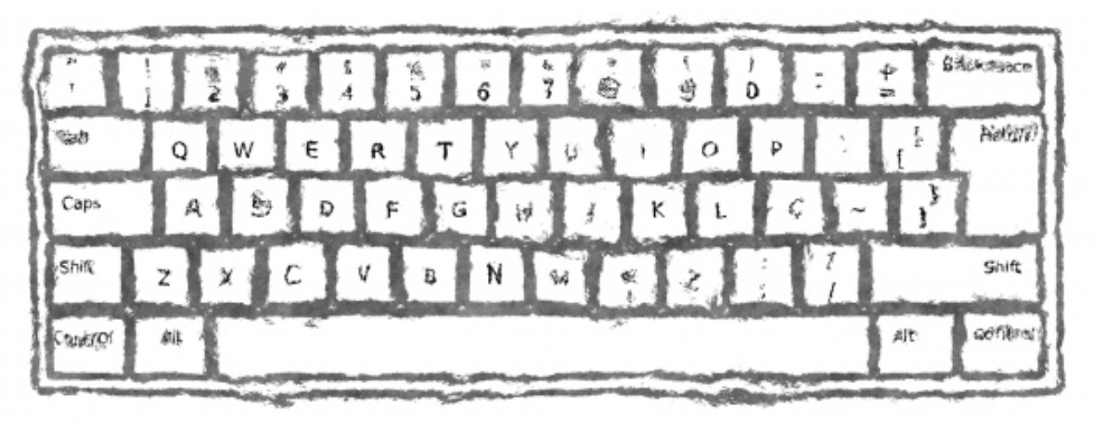
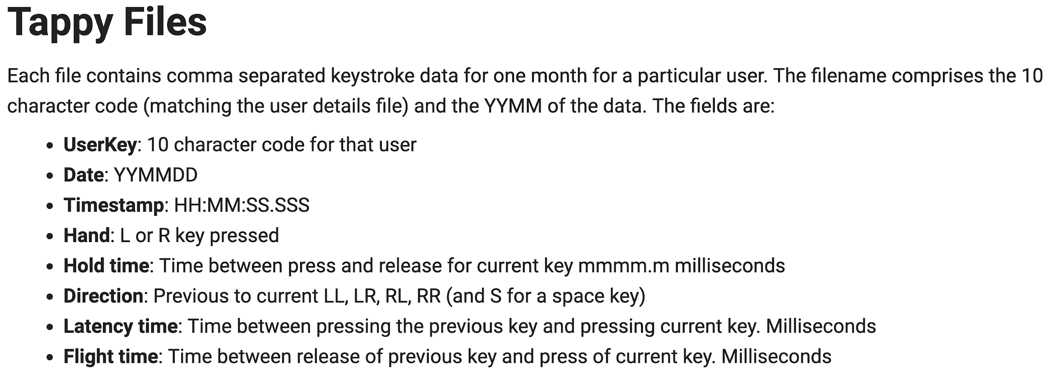
Notes:
Quick overview on the tappy file structure

Slide 4
Notes:
What does hand mean?

Slide 5
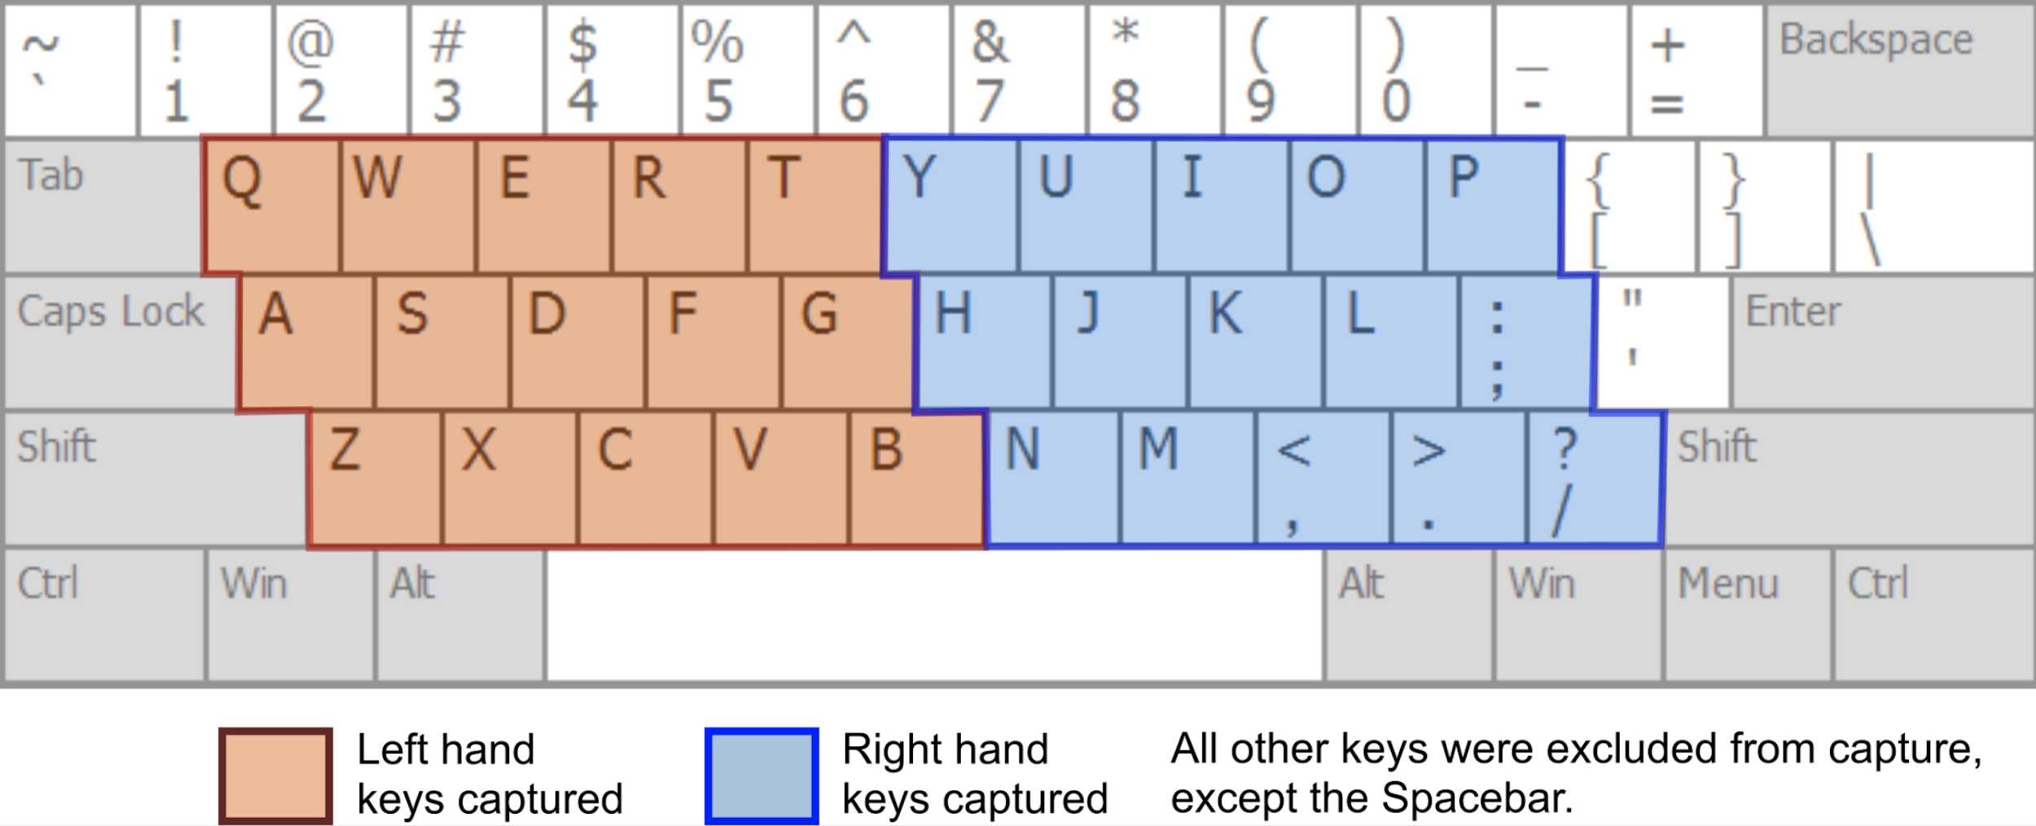
Source: https://journals.plos.org/plosone/article?id=10.1371/journal.pone.0188226#sec008

Slide 6
Notes:
What about hold time, latency and flight?

Slide 7
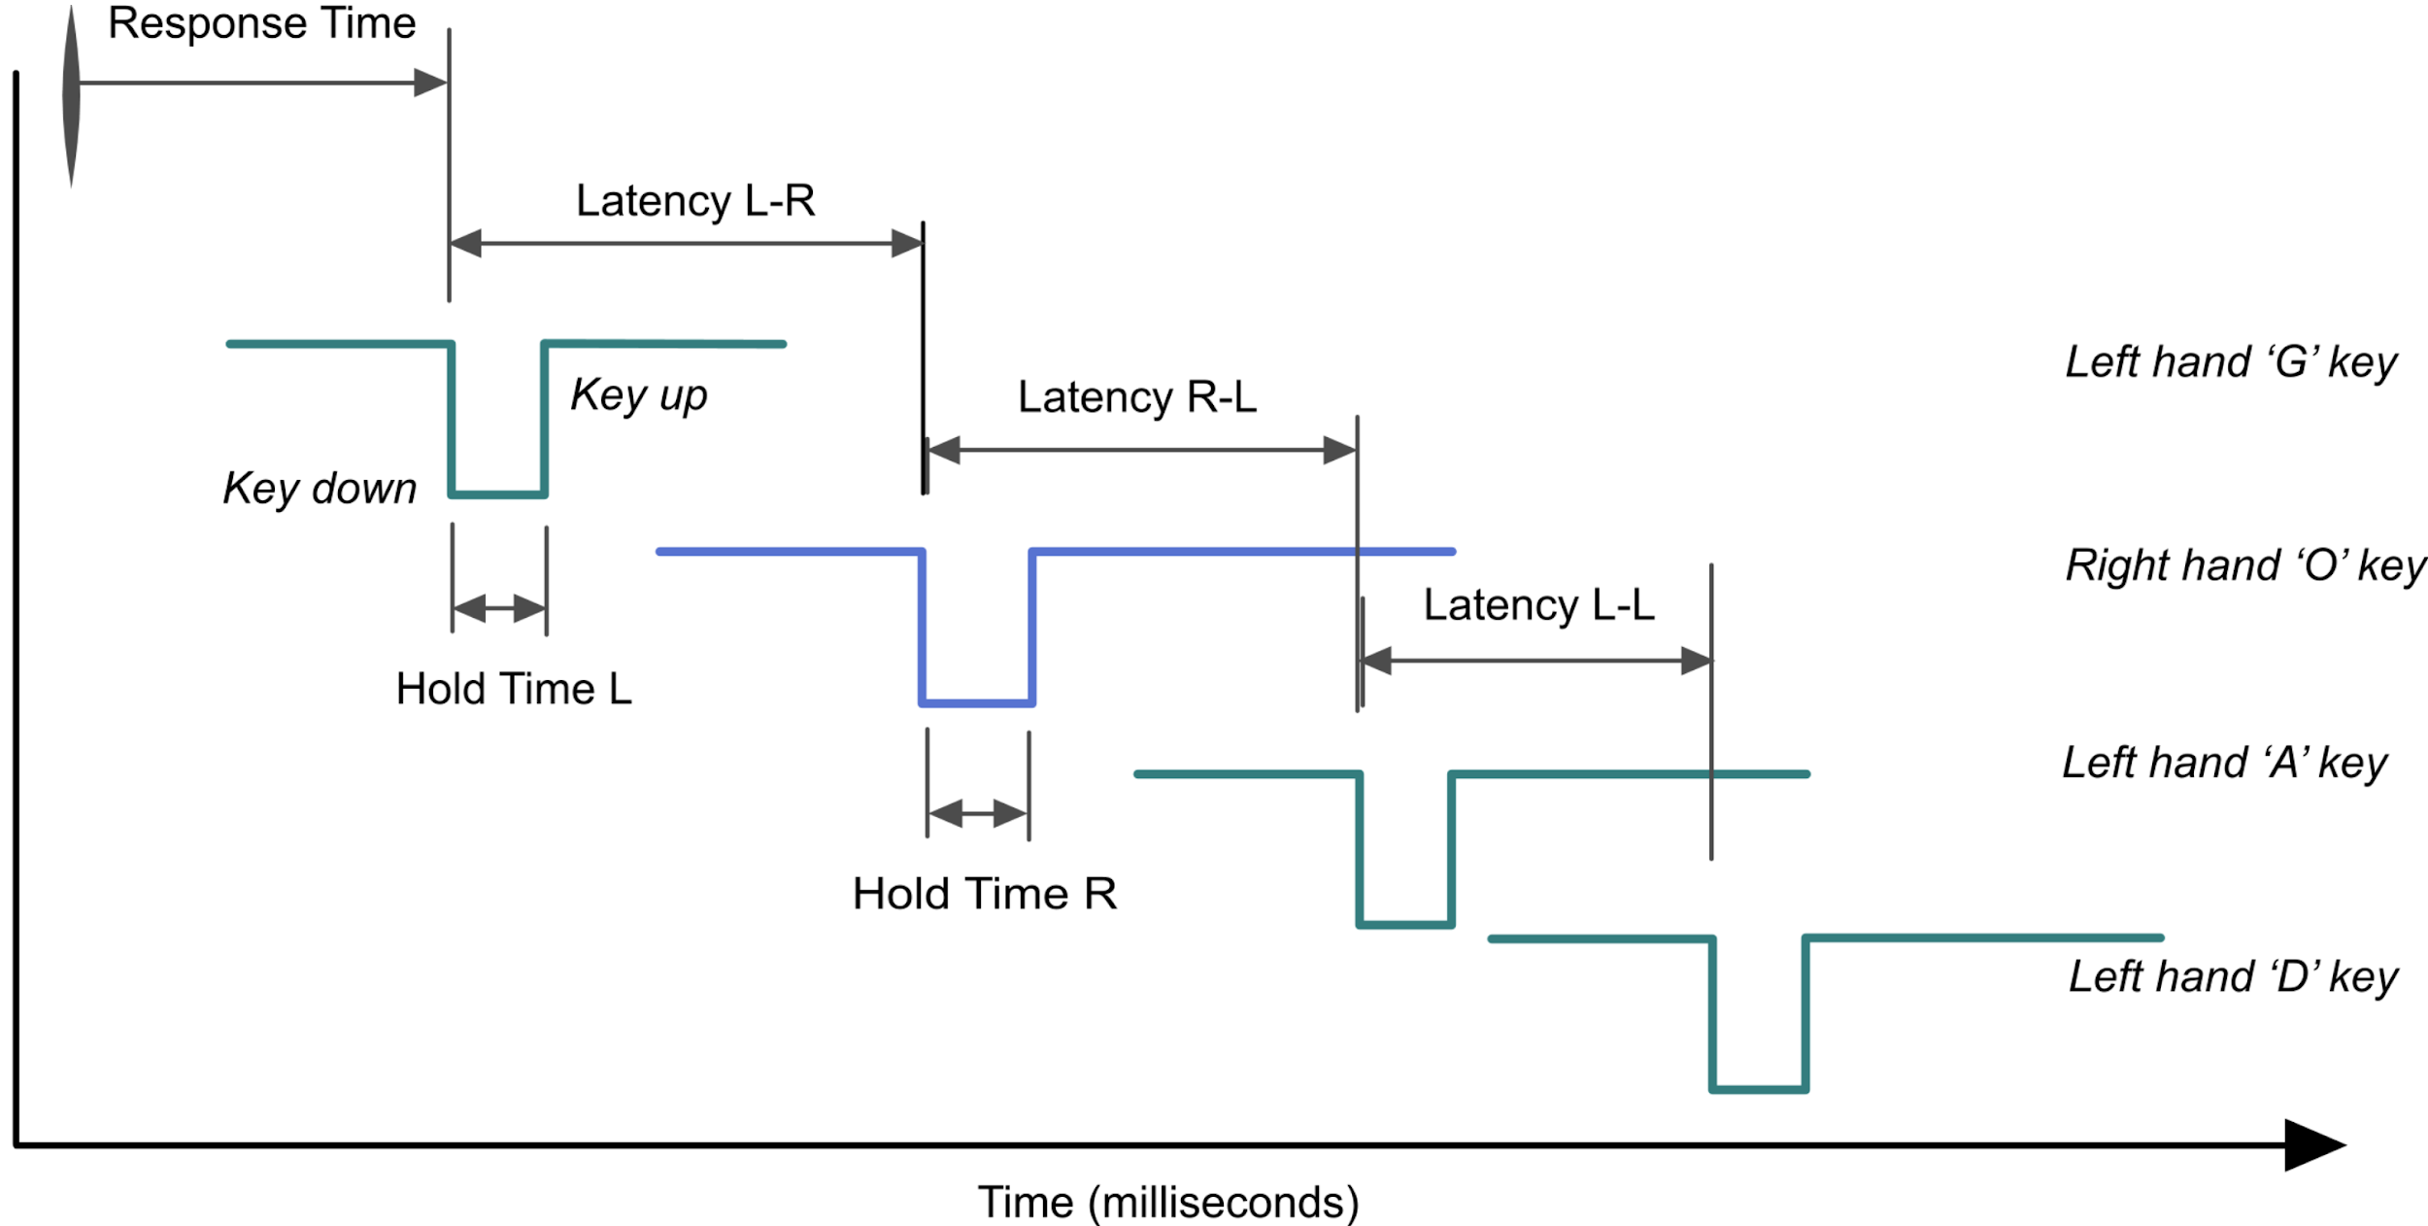
Source: https://journals.plos.org/plosone/article?id=10.1371/journal.pone.0188226
Notes:
Typing GOAD

Slide 8
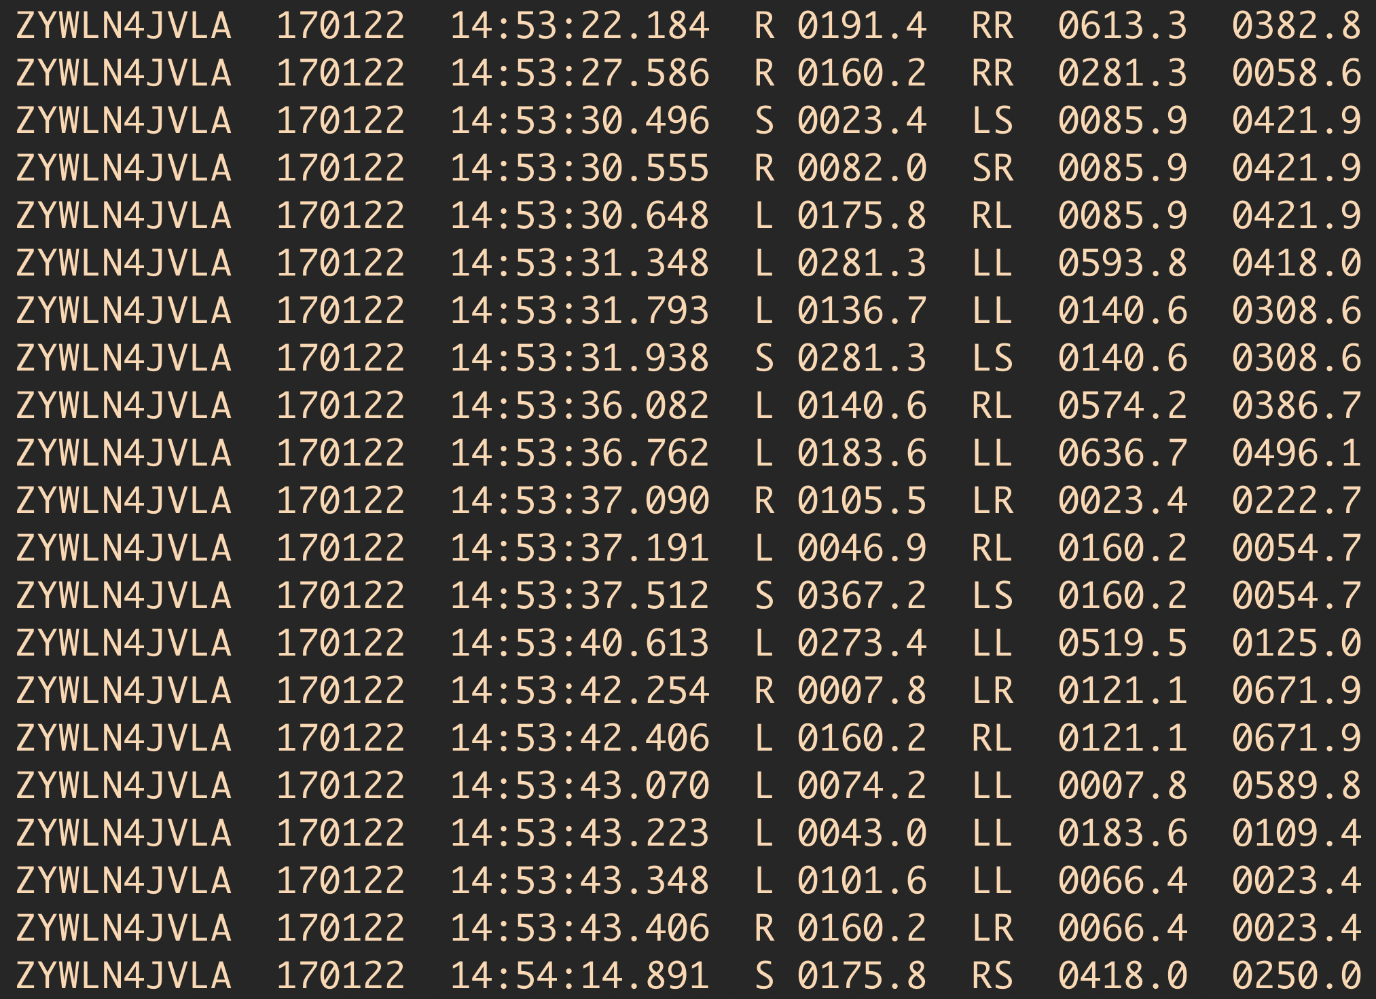
ZYWLN4JVLA_1701.txt
> One file for each subject in each month
- Total of 622 files to load
- …..
Notes:
The raw tappy data #1

Slide 9
ZYWLN4JVLA_1701.txt
- One file for each subject in each month
> Total of 622 files to load
- …..
Notes:
The raw tappy data #2

Slide 10

ZYWLN4JVLA_1701.txt
- One file for each subject in each month
- Total of 622 files to load
> We cannot directly load as a dataframe
Notes:
BAM!!!
Our first hit on the wall!

Slide 11
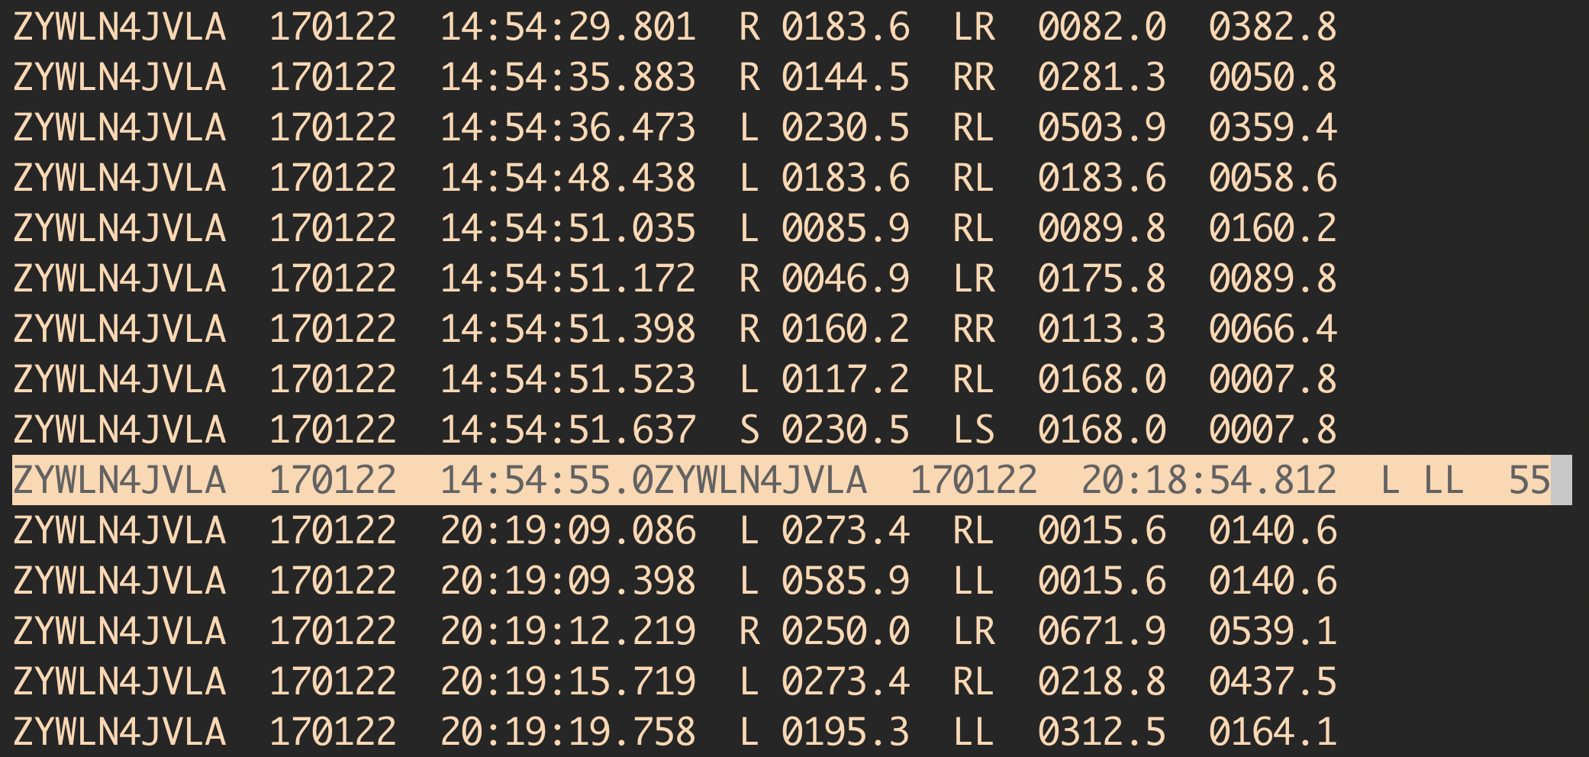
FTP or recording app is truncating...
Notes:
Example of a broken line...

Slide 12
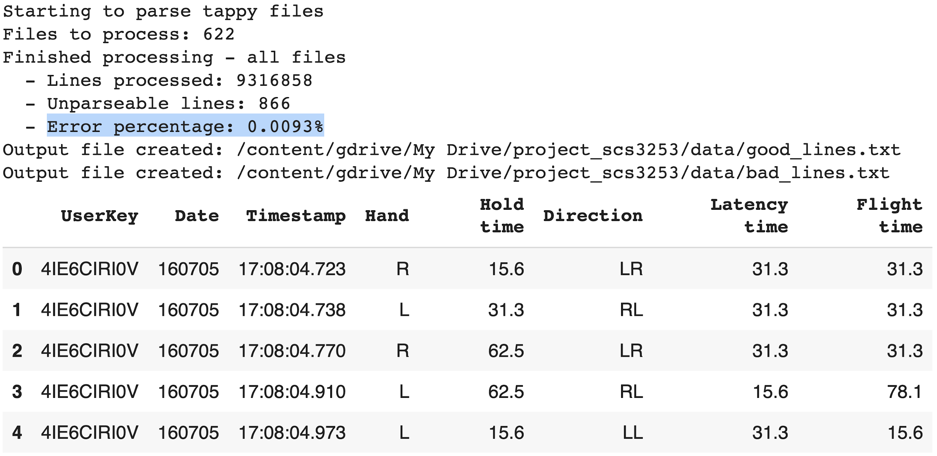
Regular expression for the win
Notes:
Our first extraction level: parsing raw data with REGEX

Slide 13
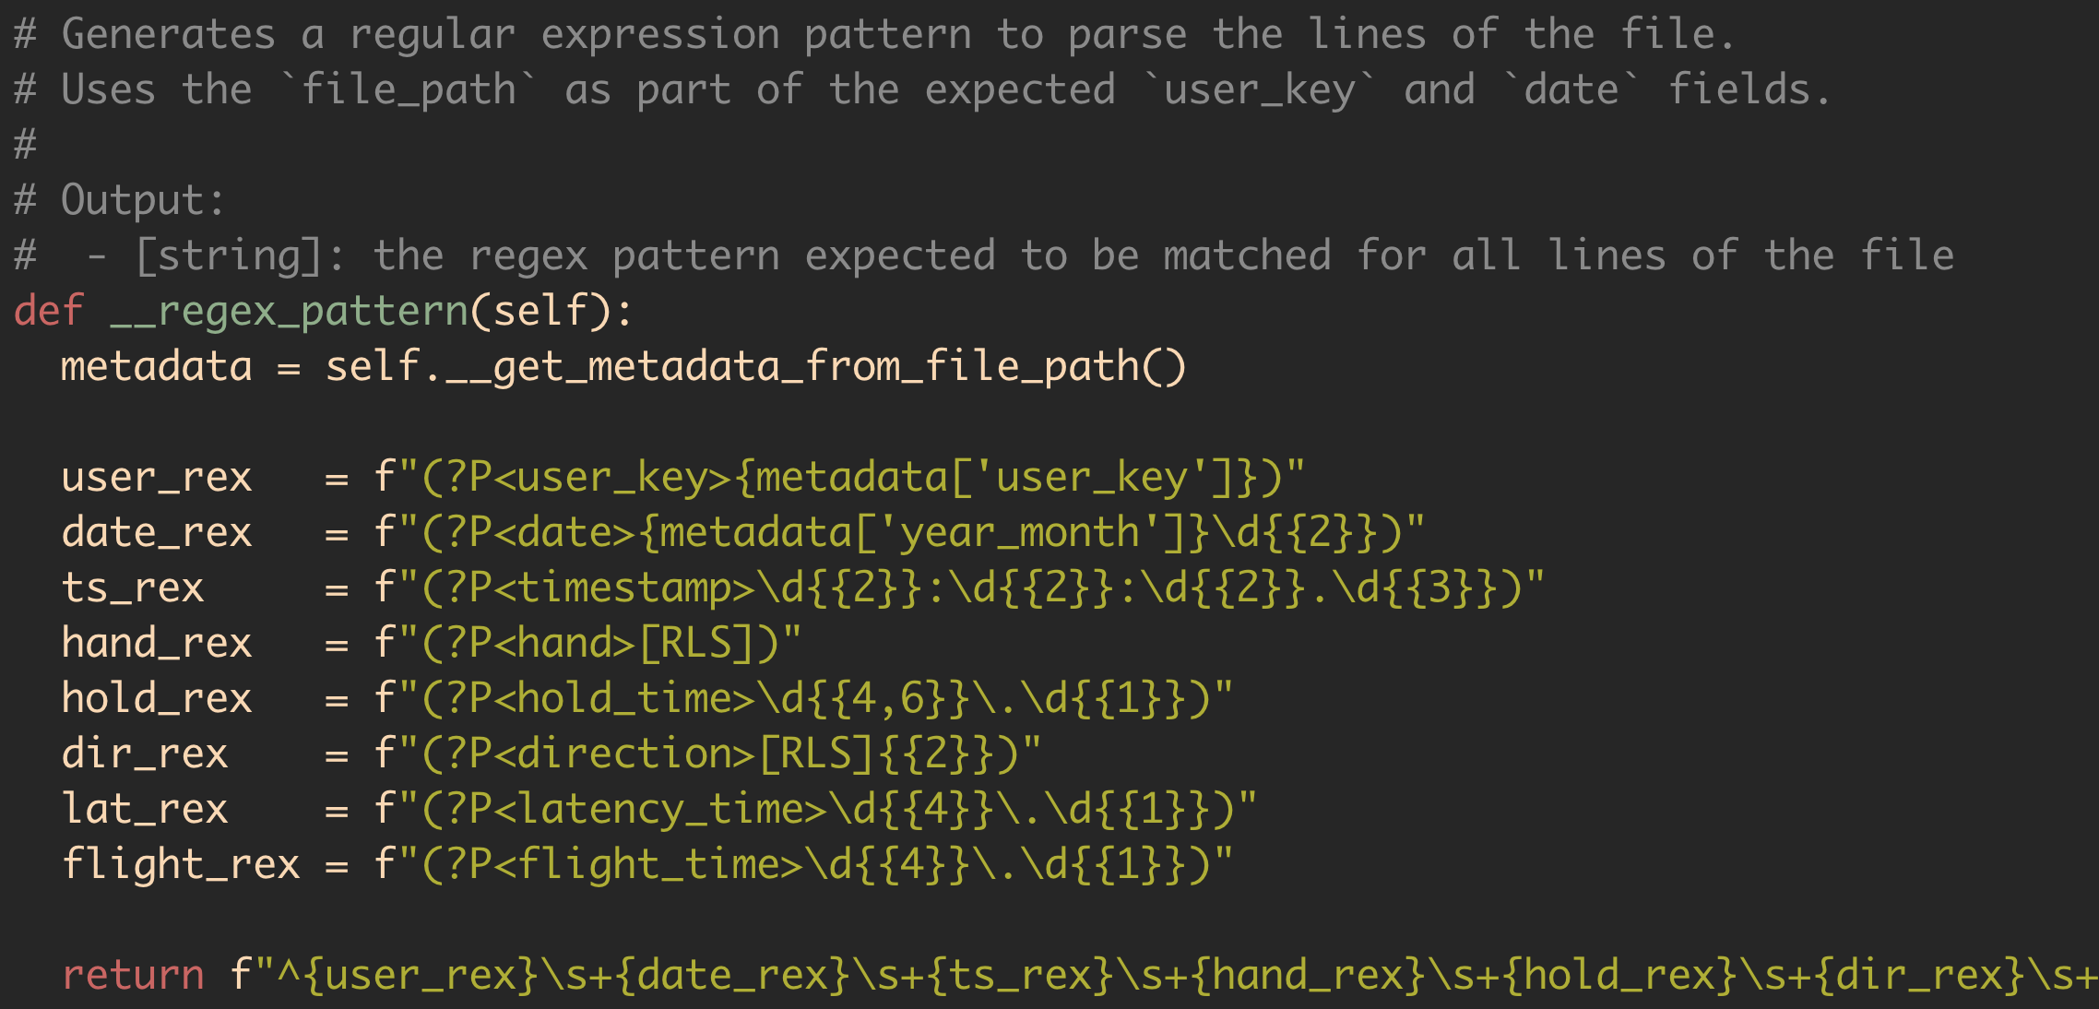
Regular expression??
Notes:
Example of a tappy REGEX

Slide 14
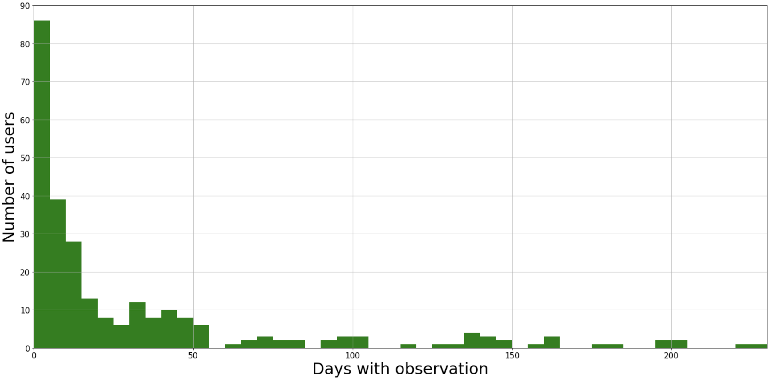
Exploring tappy dataset
~125 users with less than 10 days of data = ~47% of all users
Notes:
Now it’s almost 50%!
Basically, from ~10m keystrokes > 266 users > around 100 after a lot of work

Slide 15
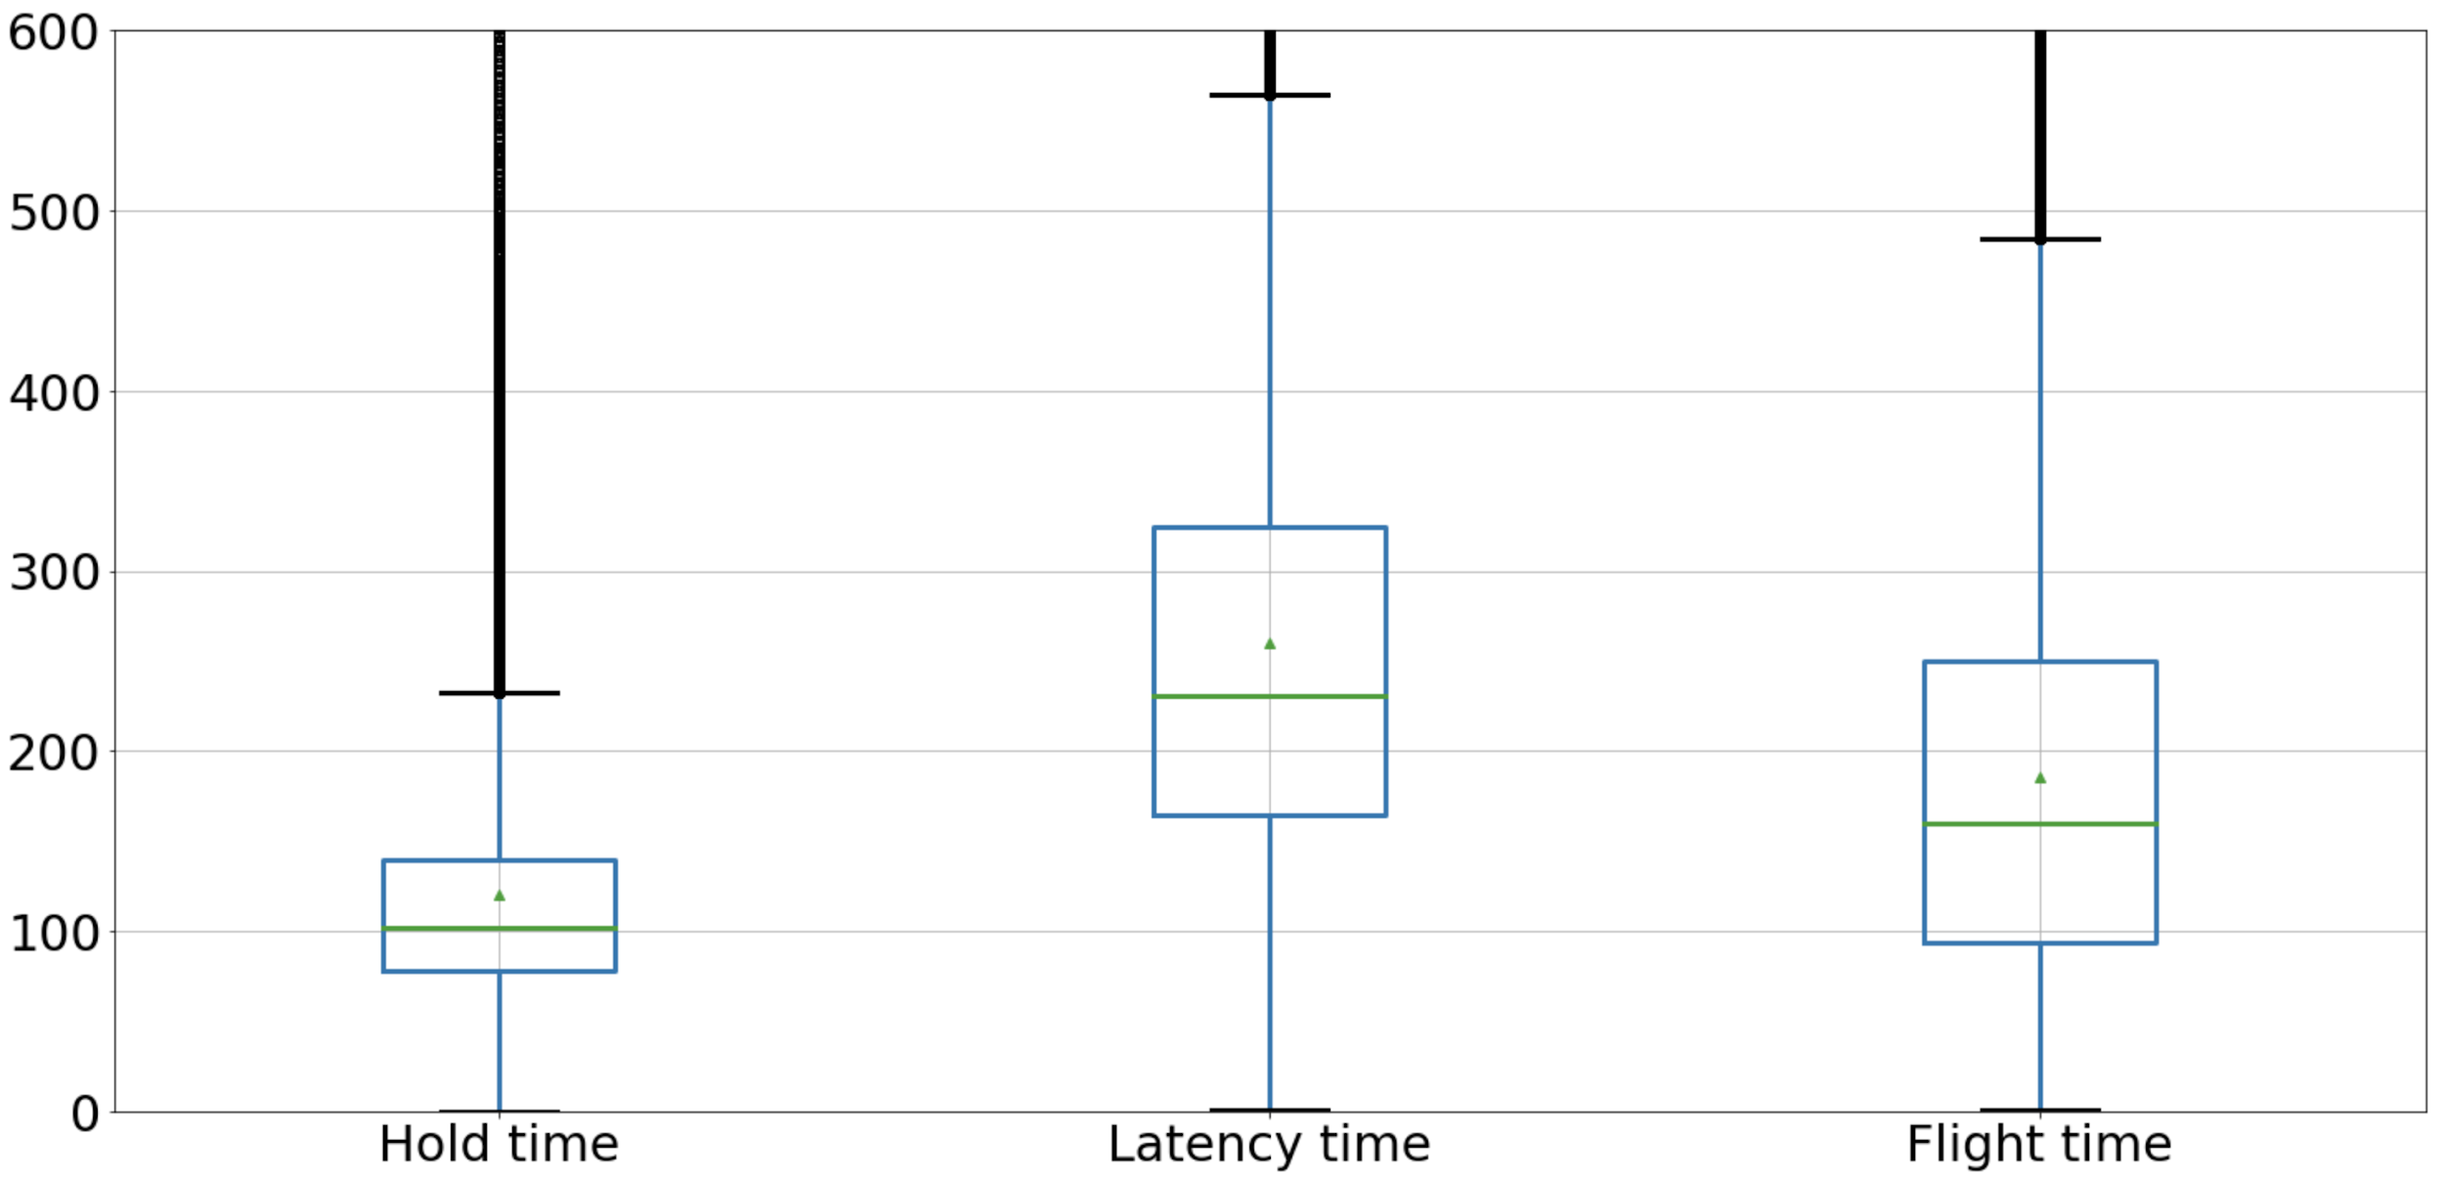
Exploring tappy dataset
Notes:
Latency and flight time are maxing out on 800ms but HOLD TIME...

Slide 16
Exploring tappy dataset
- Outliers from 233 ms
- Max ~15 minutes!!!!!
Notes:
Did someone sleep on the keyboard??

Slide 17
Exploring tappy dataset
- Outliers from 233 ms
- Max ~15 minutes!!!!!
- ~360k records
Notes:
Is it reasonable to consider a keypress lasting longer than 233 ms?
What if these outliers are relevant?

Slide 18

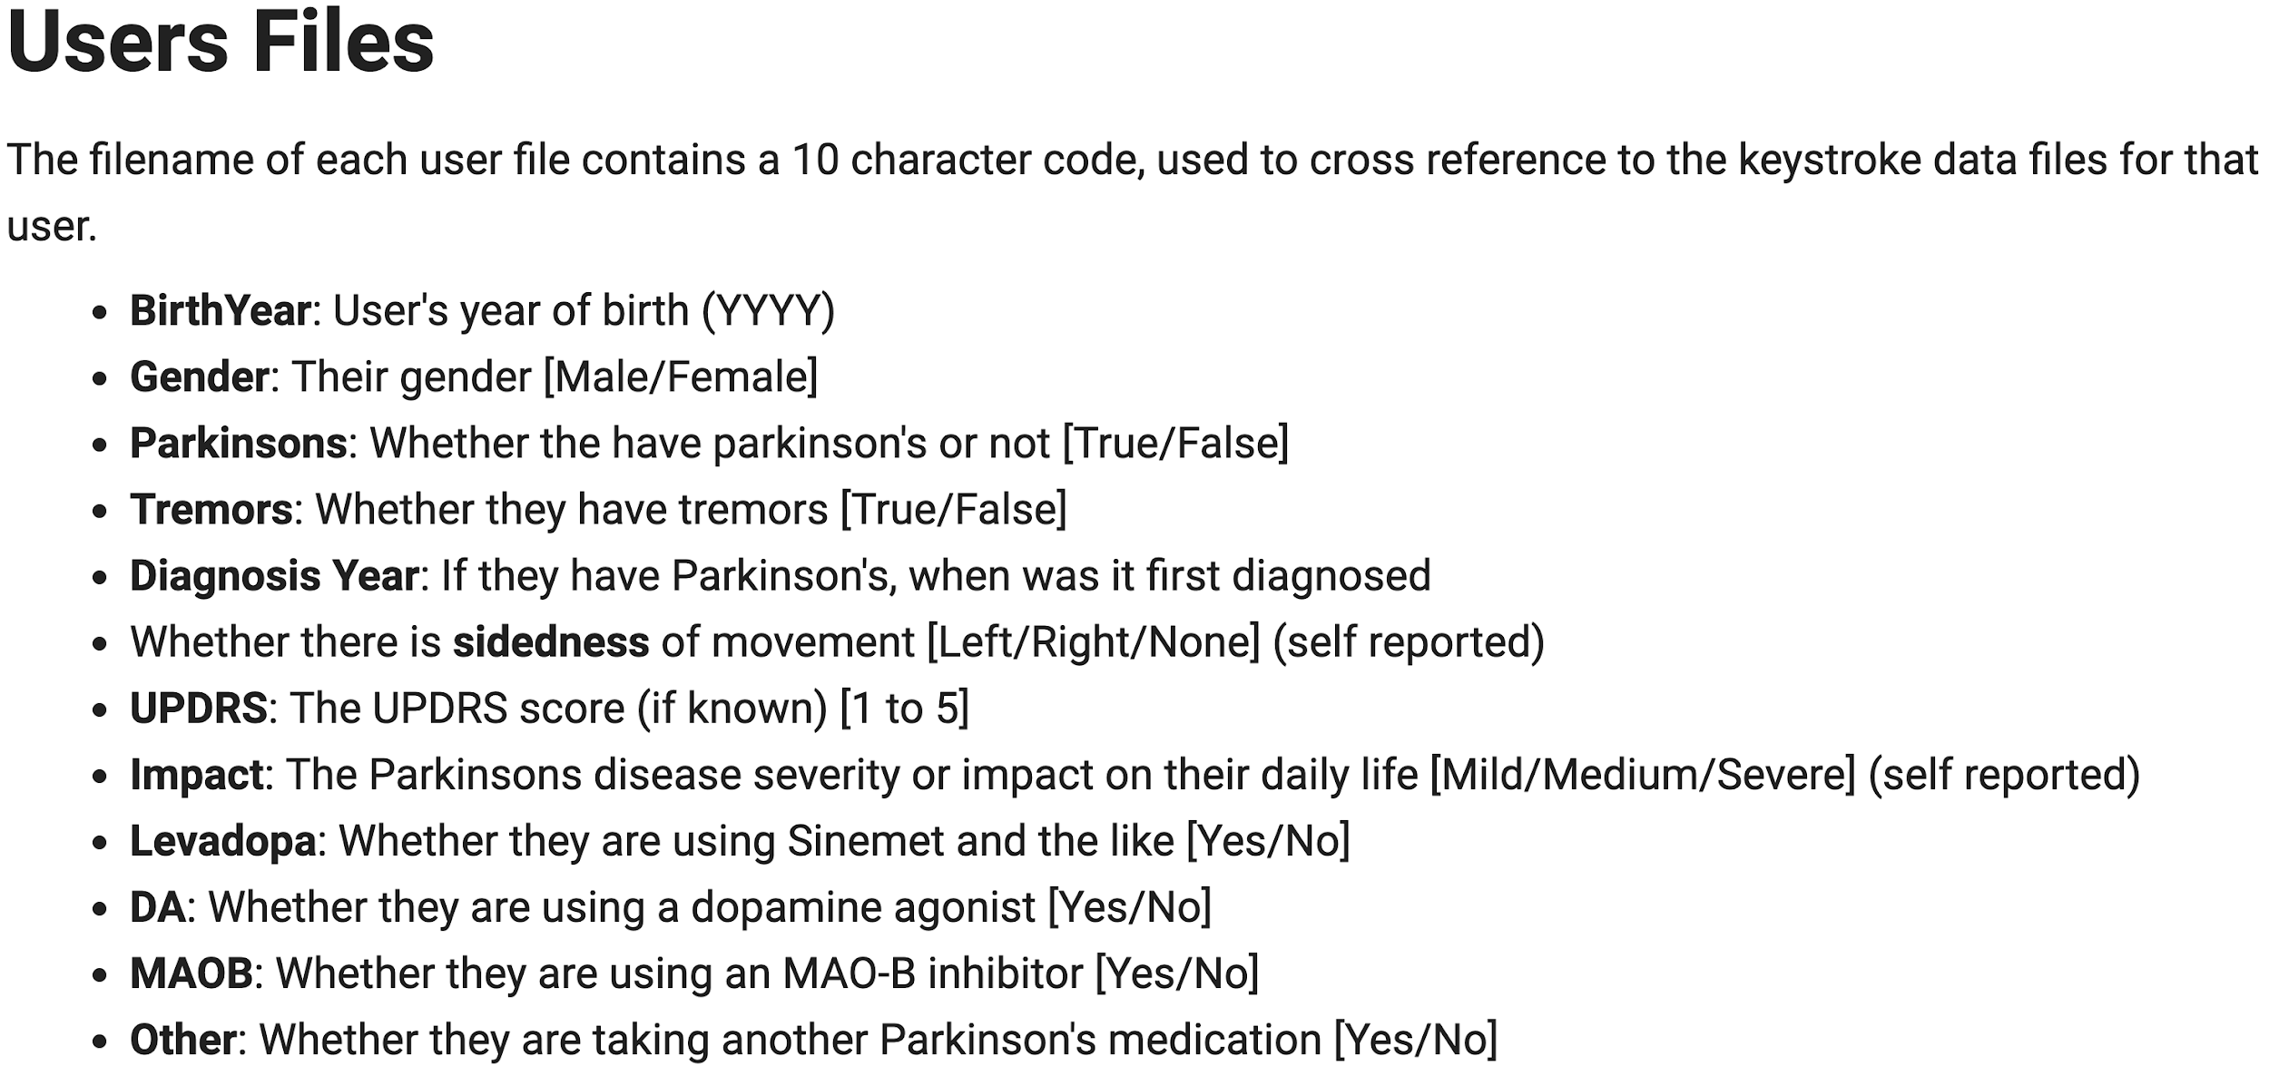
Notes:
Quick overview on the user file

Slide 19

Our target variable!!
Notes:
Target, basic info (like gender etc), medication...
UPDRS = Unified Parkinson’s Disease Rating Scale

Slide 20
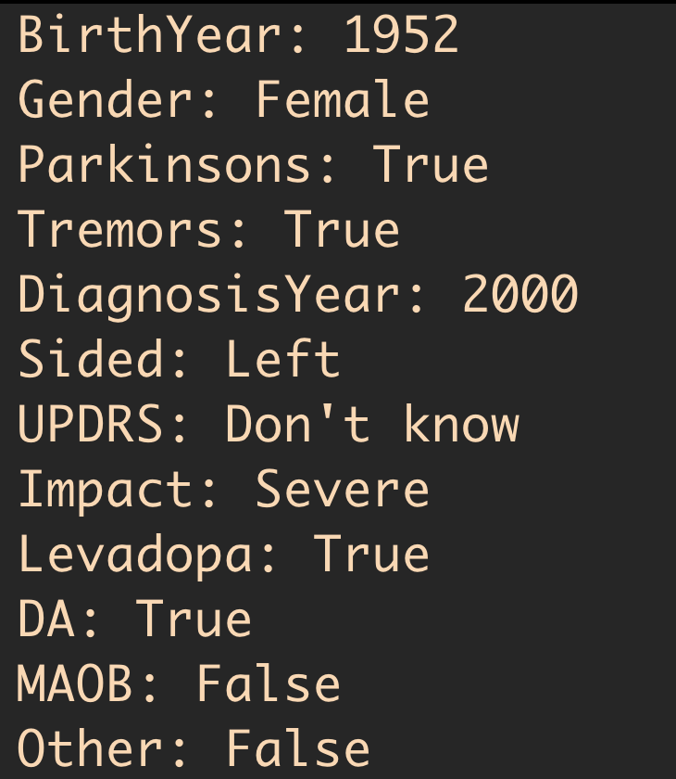
User_0EA27ICBLF.txt
- Total of 227 files to load
- A different format / structure
- …..
Notes:
The raw user data #1

Slide 21
User_0EA27ICBLF.txt
- Total of 227 files to load
- A different format / structure
- …..
Notes:
The raw user data #2

Slide 22
User_0EA27ICBLF.txt
- Total of 227 files to load
- A different format / structure
- A bunch of missing values
- …..

Slide 23

User_0EA27ICBLF.txt
- Total of 227 files to load
- A different format / structure
- A bunch of missing values
- After merging we went down to 217 users
Notes:
PAAAAAAAMMMM!!!
From 266 we went down to 227 (users files), and after merging the dataset, down to 217

Slide 24
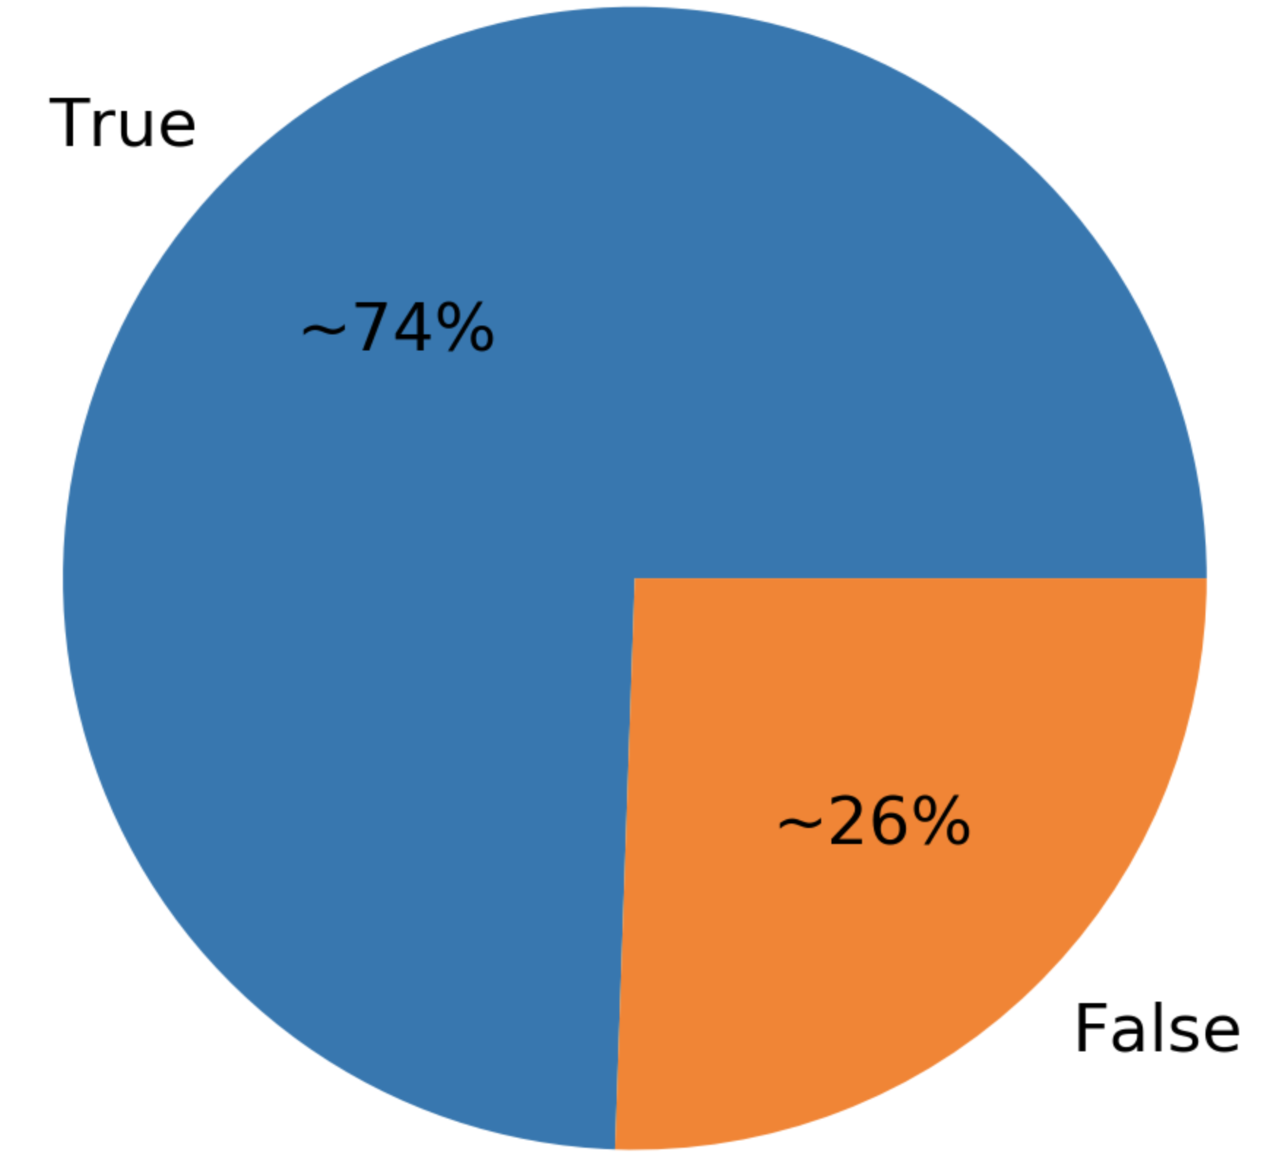
Imbalanced dataset
User with Parkinson?
Notes:
Another challenge

Slide 25
Feature Engineering

Slide 26

Data Cleaning
OK, maybe not ALL.
Just the ones we need.

Slide 27
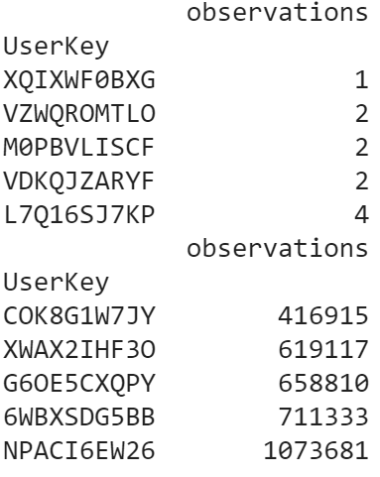
Some users have very little data
Head
Remove users with < 1000 observations (keystrokes)
Tail

Slide 28
Removing not useful data & outliers
Remove the keystrokes with hold_time > 1000ms
(0.999 percentile cut off is 445.3)
Removing keystrokes involve “S” (space bar is not very useful in finding hand movement)
Remove flight_time column as it is redundant
flight_time = latency_time - hold_time

Slide 29
Fixing NaN
Impact
For non Parkinson users, create a new category = None
For Parkinsons user (only 4 with missing Impact), use Mode ( Medium)
Sided - 108 users missing that data
All users with no Parkinson are missing this field
It could be a useful data, but have to drop

Slide 30
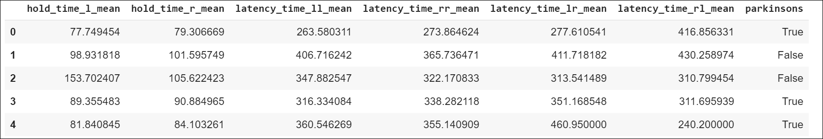
Basic features
6 features: mean of each hold_time and latency_time
Notes:
F1 : 0.851406 (Train) | 0.857143 (Test)
Precision: 0.741259 | 0.750000
Recall : 1.000000 | 1.000000
> Accuracy : 0.741259 | 0.750000

Slide 31
More features?
Diff and Abs_diff for hold_time_mean for L and R
=> 2 new feature
Diff and Abs_diff for latency_time_mean for LR <-> RL and LL <-> RR
=> 4 new features
Std, Skew, Kurtosis of each mean
Holdtime (L, R) => 6 new features
Latency_time (LL, LR, RL, RR) => 12 new features
Now we have 30 features in total
Notes:
Will talk through the thought process

Slide 32
Training Models

Slide 33
Tedious to train model one by one...
Use Pipeline and functions to train and compare models
training_pipeline = Pipeline(verbose=False, steps=[
('pol', PolynomialFeatures(degree = 1)),
('nor', Normalizer()),
('clf', EstimatorDecorator())
])
param_grid = [{
'clf__estimator': [RandomForestClassifier()],
#… and all other models}]
best_models, grid_search =
train_and_select_any_top_n(X_train, y_train,
training_pipeline, param_grid,
cv=3, scoring=’f1’)

Slide 34
Selecting models
Training Pipeline
X_train,
y_train
Best Model 1
Best Model 2
Models + Parameters
...
Best Model n
Best models
(based on f1_score)
Models included:
RandomForestClassifier, LogisticRegression, SVC,GradientBoostingClassifier, KNeighborsClassifier, GaussianNB, DecisionTreeClassifier, XGBClassifier, AdaBoostClassifier

Slide 35
Testing Pipeline
X_test, y_test
Preprocessing
Remove Outliers
Create additional features
PolynomialFeatures (degree=2)
Normalizer
Best Model 1
Best Model 2
...
Best Model n
Trained models
from previous step
Prediction
...
Prediction
Prediction
Voting
Final Prediction

Slide 36
Results

Slide 37
VotingClassifier (soft)
> F1 delta (train-test): 0.004963
> Scores <train> | <test>
> F1 : 0.853448 | 0.848485
> Precision : 0.744361 | 0.736842
> Recall : 1.000000 | 1.000000
> Specificity: 0.000000 | 0.000000
> Accuracy : 0.744361 | 0.736842
> AUC : 0.500000 | 0.500000
Looks pretty good, except….

Slide 38
“Always True” Classifier
It is same as the Always True Classifier…
> Scores <train> | <test>
> F1 : 0.853448 | 0.848485
> Precision : 0.744361 | 0.736842
> Recall : 1.000000 | 1.000000
> Specificity: 0.000000 | 0.000000
> Accuracy : 0.744361 | 0.736842
> AUC : 0.500000 | 0.500000
>
> ConfMatrix : [[ 0 34] | [[ 0 15]
[ 0 99]]| [ 0 42]]
Notes:
Model: 0 - VotingClassifier
{'>estimator<': 'VotingClassifier', 'voting': 'hard'}
> F1 delta (train-test): -0.006940
> Scores <train> | <test>
> F1 : 0.850202 | 0.857143
> Precision: 0.739437 | 0.750000
> Recall : 1.000000 | 1.000000
> Accuracy : 0.739437 | 0.750000
> AUC : 0.500000 | 0.500000
Model: 1 - VotingClassifier
{'>estimator<': 'VotingClassifier', 'voting': 'soft'}
> F1 delta (train-test): -0.006940
> Scores <train> | <test>
> F1 : 0.850202 | 0.857143
> Precision: 0.739437 | 0.750000
> Recall : 1.000000 | 1.000000
> Accuracy : 0.739437 | 0.750000
> AUC : 0.500000 | 0.500000

Slide 39

What to do?
Are we using the right data set?

Slide 40
“Early stage of Parkinson’s….”
Keyword: Early stage
May need further filtering...
=> Only include Parkinson’s users with Mild impact.

Slide 41
VotingClassifier (soft)
> Scores <train> | <test>
> F1 : 0.850000 | 0.857143
> Precision : 0.739130 | 0.750000
> Recall : 1.000000 | 1.000000
> Specificity: 0.636364 | 0.625000
> Accuracy : 0.820896 | 0.823529
> AUC : 0.818182 | 0.812500
> Conf Matrix: [[21 12] | [[5 3]
[ 0 34]]| [0 9]]

Slide 42
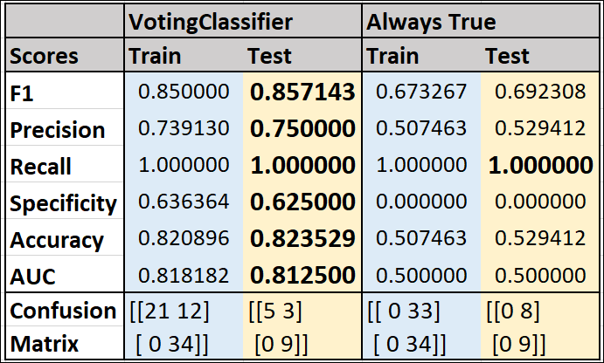
Compare with “Always True” predictor
Notes:
After we changed the filtering criteria, we have relatively balanced dataset, may not be best to compare to “Always True” classifier anymore.

Slide 43
Conclusion
Models improved to over 0.8 (both f1_score and accuracy) after reducing the dataset to:
Keystroke data with <= 1000ms hold time
At least 1000 keystroke data per user
User with Parkinson’s impact == Mild only
The models can further be improved as the research paper has obtained over 0.9 sensitivity and specificity.

Slide 44
Thank you!

